Slide 1
Lecture 1: quantitative Chemistry and regenerative Biology
Brought to you by Christine Hamadani
Section 1: Sun 2:30pm--4:00pm
S11472

Slide 2
About me
Instructor:
Christine Hamadani, graduate student
Department of Otolaryngology
Eaton Peabody Labs
Harvard-MIT Speech and Hearing Bioscience and Technology Program
Harvard Medical School

Slide 3
expectations
Meetings: July 9th to August 13th.
Assessment: All students will take three short pass/fail quizzes (30%), a midterm exam (30%), and a final exam (40%). Quizzes will be pass/fail, and are designed to prepare students for upcoming exams.
Attendance: Attendance is strongly encouraged. There will be 3 pass fail quizzes. You should take lecture notes.
Grading:
A 93-100% A- 90-92% B+ 87-89% B 83-86% B- 80-82% C+ 77-79% C 73-76% C- 70-72% D+ 67-69% D 63-66% D- 60-62% E

Slide 4
Learning outcomes
1) Students will gain fluency in a broad range of topics in quantitative chemistry, biochemistry, and molecular biology.
2) Students will be able to access various resources related to the neurological, chemical, and biological basis of disease.

Slide 5
Schedule (tentative)
1: Introduction to Quantitative Chemistry: Acid-Base
2: Introduction to Neurobiology and Molecular Biology: Enzyme Kinematics, Cell death and repair, and Protein degradation--- Quiz 1
3: The Neuro-Biochemical basis of Disease: Neuronal Mechanisms, Schizophrenia, Parkinson’s, Amnesia --- Midterm Exam
4: Tissue Regeneration: Breakthroughs in Auditory Hair Cell Repair---Quiz 2
5: Cancer: Cause, Effects, and Clinical studies---- Quiz 3
6: Final Exam

Slide 6
Let’s get started on Types of acids:
Arrhenius – Free ions in aqueous solution
Brønsted–Lowry – Protons!
Lewis – Electrons!

Slide 7
Arrhenius sucks
Only focuses on ions in solution.
Doesn’t describe much.
BL is easy
Lewis is fun

Slide 8
Brønsted–Lowry
Follows the transfer of protons – yes, the same thing atoms are made of.
Does NOT come from the atoms.
Protons in BL reactions are free positive hydrogens.
Very useful for describing many reactions.
Incomplete, Lewis is better, but much more complicated.

Slide 9
Lewis Acids
Literally the best.
Follow the electrons – (just like organic chemistry) :D.
Describes both BL acid/base reactions and Arrhenius acid/base reactions (Do not be confused. Arrhenius is still terrible).
Not our focus.

Slide 10
Acids
SO FIRST, WHAT IS AN ACID???????
Its general definition is that it is a molecule or charged particle(ion) that is expected to give away a positively charged hydrogen particle (H+ proton) in an environment assuming equilibrium.
When a molecule releases H+ in a solution, it’s called DISSOCIATION

Slide 11
Why Brønsted–Lowry
Applicable to most reactions.
Simple to understand
Please, don’t ever let anyone teach you Arrhenius.

Slide 12
Examples:
Brønsted–Lowry:
Lewis:
Arrhenius:
Just kidding.

Slide 13
Examples of acids
Hydrochloric acid (HCl) in gastric juice.
Sulfuric acid (H₂SO₄)
Nitric acid (HNO₃)
Carbonic acid in soft drink (H₂CO₃)
Uric acid in urine (HC₅H₃N₄O₃ )
Ascorbic acid (Vitamin C) in fruit (C₆H₈O₆ )
Citric acid in oranges and lemons (C₆H₈O₇ )
Acetic acid in vinegar (CH₃COOH)

Slide 14
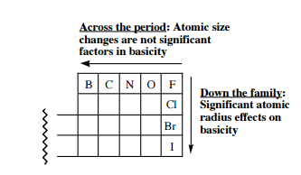
BASES
it is a molecule or charged particle(ion) that is expected to accept that H+ proton that acids will donate away in a reaction, generally assumed at equilibrium.

Slide 15
Examples of bases
Blood
Antacid
Baking soda
Ammonia
Drain-o
Egg whites
KOH
NaOH

Slide 16
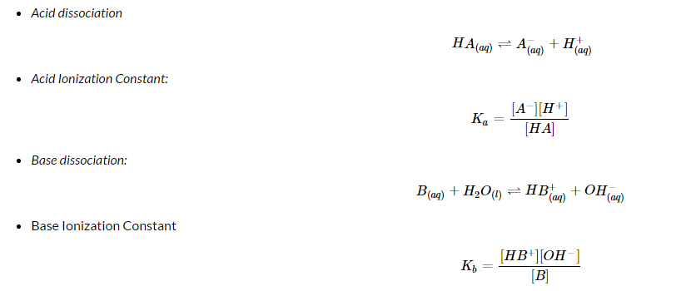
Brønsted-Lowry acid and base behavior in solution
LOW values of Ka mean that the acid does NOT dissociate well and that it is a WEAK acid.
The same logic applies to bases.

Slide 17

An example

Slide 18
Ka, or the acid dissociation constant, is an equilibrium constant for the dissociation of acids: Strong acids completely dissociate in water, while weak acids only partially dissociate.
Kb, or the base dissociation constant, is the equilibrium expression for bases.
IN WATER (aqueous solution)!: BASES AND ACID COMBINES TO MAKE EQUILIBRIUM
Kw is the water dissociation constant and is defined as the dissociation and ionization of water. Kw is always 1.0 x 10^-14 when the water is at 25 degrees Celsius. The relationship between Kw, Kb and Ka allows us to determine the relative strength of an acid or a base by comparing it to the Kw value.

Slide 19
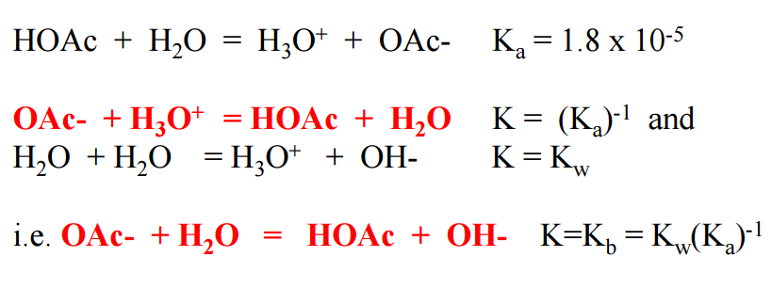
What happens to DISSOCIATION CONSTANTS if we FOR EXAMPLE put sodium acetate(salt) in water?
All salts are made up of acids and bases. Ka signifies dissociation constant of acid and Kb is for the base. [Ka][Kb] = Kw, the total dissociation constant of water:

Slide 20
What does Ph Mean?
pH is a more easily understood measure of the concentration of acidity, [H+].
Brackets, [ ] mean concentration.
[H+] is related to Ka described above, as we’ll see.
Notes:
Talk about molarity and what a mole is.

Slide 21
Ka, pka, and ph
[H+], usually in mol/L (molarity), can range from very small to exceptionally large.
Because of this, we use powers of these numbers;
The “p” in pKa and pH stands for power, as in log10(x), however, these measures, without a particular reason, are negative.
That is to say, the pKa of an acid is derived from Ka by taking the negative base 10 log of the Ka.
The same is true for pH; take the negative log10 of the concentration of H+ species.

Slide 22
Pka and ph
This is a consequence of math that isn’t difficult to work out, but is equally unnecessary to describe here.
When pH=pKa for a given acid in a solution, the acid will be protonated 50%
When pH=/=pKa, the ratio will grow or shrink by 1:10 for each logarithmic unit;
For example, the pKa of para-toluenesulfonic acid is -2.8
If we placed 10g p-TSA in 10L of 2 pH HCl solution, the ratio of tosylate to p-TSA would be 10^(-4.8)

Slide 23
But how do we calculate Ka?
Situation:
Find the K_{a} of a weak acid from the pH of its solution.
A 0.10M solution of formic acid, HCOOH, has a pH = 2.38 at 25ºC. Calculate the K_{a} of formic acid.

Slide 24

First step
FIRST! Write down the equation. It’s okay if you don’t know what formic acid is, as long as you have the formula, you can figure out its equation:

Slide 25
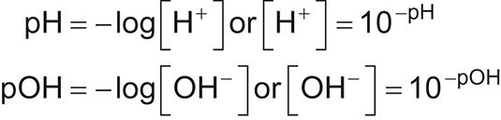

2nd step
We were given the solution pH so we can calculate the the equilibrium concentration of H⁺ :

Slide 26

3rd step
We were given initial concentration of formic acid. As the acid dissociates and breaks up into HCOO⁻ and H we will LOSE x amount of moles. Likewise, HCOO and H will GAIN x amount of moles. We represent this in an ice table.

Slide 27
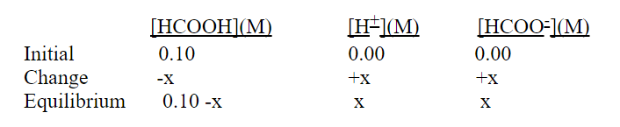

Set up I.c.e table to create equation

Slide 28
Final step: solve for ka
Assume that all of the H⁺ comes from the acid, and none from water.
We know that the [H⁺]_{eq} = 4.17 x 10⁻³ which is much higher than the 1.0 x 10⁻⁷ M H⁺ from water.
We can also see that the concentration of HCOOH will change very little, from 0.10 to 0.10 - 4.17 x 10⁻³.
The change in concentration can be ignored if it is less than 5% of the original concentration. 0.10 M x 5% = 5.0 x 10⁻³, so the change in [HCOOH] in this problem can be ignored.

Slide 29
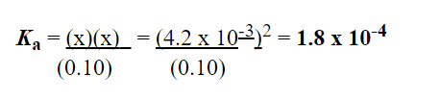
So!

Slide 30

But how much has actually ionized?
We can also calculate the percent ionization for this problem. This will represent the relative number of acid molecules which dissociate. It is calculated as :
If solved out:
(4.2 x 10⁻³)/ (0.10)}x 100 = 4.2%!!!!
!!!!Very little acid as ionized, verified it is a weak acid. Strong acids and bases would ionize 100%

Slide 31
Class problem
Find the pH of a solution, given the K_{a} of a weak acid.
Calculate the pH of a 0.10 M HF solution, given that the K_{a} = 6.8 x 10⁻⁴ at 25ºC *
*Hint! *Change from original concentration is greater than 5%, think about the quadratic formula*

Slide 32

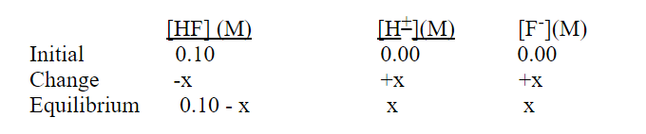

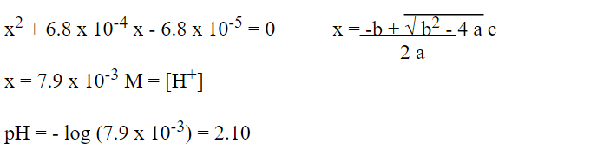
answer

Slide 33
BALANCING reactions
Balancing of reactions, known as stoichiometry, is a fundamental concept in chemistry.
A balanced chemical equations will carry equimolar amounts of each type of atom on either side of the equation, and will give positive integers coefficients each reactant and product.
Example:

Slide 34
balancing acid-base reactions
Most acid base reactions will have the form:
AcidH + Base(-) -> Acid(-) + BaseH
Acid(-) is known as the conjugate acid, and BaseH is known as the conjugate base.

Slide 35


First, identify redox rxns
Take the reaction you’re interested in and split it into 2 reactions. Then label each. Is it a reduction reaction, or an oxidation reaction?
In our overall reaction, copper oxidation state on the left side is 0 since it is a single element, and increases to 2+ on the right side: it is oxidized as the oxidation states increases in charge .
Also in our overall reaction, silver goes from an oxidation state of +1 on the left to 0 on the right, which is because it is an element on its own. Because the oxidation state of silver decreases from +1 to 0, this is the reduction half-reaction.
reduce
oxidate

Slide 36
What are the two reactions for this equation?
Cl2 (aq) + 2KI(aq) => I2 (s)+ 2KCl(aq)

Slide 37
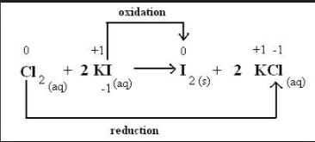
answer

Slide 38
board examples
Zn(s) + (2H+) (aq) => (Zn2+)(aq) + H2(g)
Zn (s) + (Cu2+) (aq) => Cu (s) + (Zn2+)(aq)

Slide 39

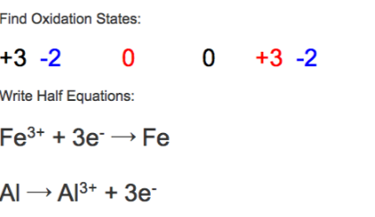
Balancing reactions

Slide 40

THEN, how to Balance reactions in acidic conditions…
1.) Break equation into redox half reactions:

Slide 41

Balancing in acid
2.) Balance elements other than O and H. In this example, only chromium needs to be balanced. This gives:

Slide 42

Balancing In acid
Step 3: Add H₂O to balance oxygen. The chromium reaction needs to be balanced by adding 7 H₂O molecules. The other reaction also needs to be balanced by adding one water molecule. This yields:

Slide 43

Balance in acid
Step 4: Balance hydrogen by adding protons (H⁺). 14 protons need to be added to the left side of the chromium reaction to balance the 14 (2 per water molecule * 7 water molecules) hydrogens. 3 protons need to be added to the right side of the other reaction:

Slide 44
Balance in acid
Step 5: Balance the charge of each equation with electrons. The chromium reaction has (14+) + (2-) = 12+ on the left side and (2 * 3+) = 6+ on the right side.
To balance, add 6 electrons (each with a charge of -1) to the left side. For the other reaction, there is no charge on the left and a (3+) + (-1) = 2+ charge on the right. So add 2 electrons to the right side::

Slide 45
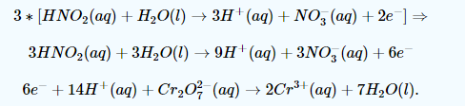
Balance in acid
Step 6: Scale the reactions so that the electrons are equal. The chromium reaction has 6e⁻ and the other reaction has 2e⁻, so it should be multiplied by 3. This gives:

Slide 46
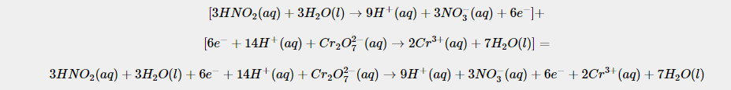
Balance in acid
LAST STEP YAY! Add the two reactions and cancel out common terms.
The electrons cancel out as well as 3 water molecules and 9 protons. This leaves the balanced net reaction of:

Slide 47
Class tries! acid condition
NO3-(aq) + Br-(aq) -> NO(g) + Br2(l)

Slide 48

Balancing in basic conditions
Break your equation into redox half reactions like before:

Slide 49


Balancing in basic
Step 2: Balance elements other than O and H, still the same way as before:
Step 3: Add H2O to balance the oxygens while you’re at it too:

Slide 50


Balancing in basic
Step 4: Balance hydrogen with protons.
Step 5: Balance the charge with e⁻ (wow nothing’s changing huh!?):

Slide 51
Balancing in basic
Both sides have 2e- so add the reactions and cancel the electrons:
BUT WAIT WOWOWOWOW A NEW STEP:
Add OH⁻ to balance H⁺. There are 2 net protons in this equation, so add 2 OH⁻ ions to each side:

Slide 52
Last step yay
Next, combine OH⁻ ions and H⁺ ions that are present on the same side to form water:
AND FINALLY! CANCEL YOUR COMMON TERMS:

Slide 53

Class tries: basic example

Slide 54
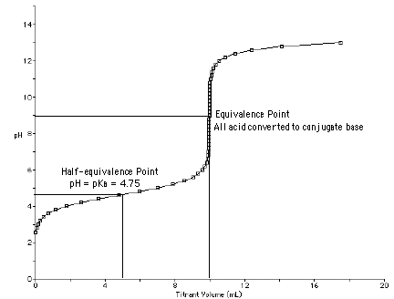
A brief note on Titration
If you’re interested to see the pH related behavior of a certain chemical, or trying to obtain a specific pH solution, titrating is the way to go
What is it? Basically, it’s adding certain amounts of base to acid, or acid to base, in order to bring the reaction to completion, or obtain a certain pH.

Slide 55
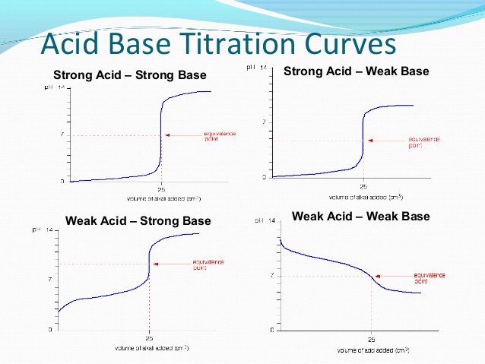

Slide 56
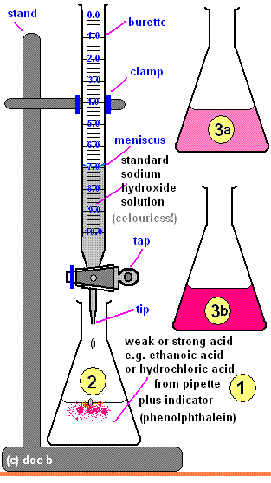
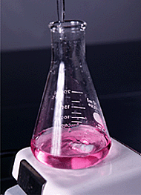

Slide 57
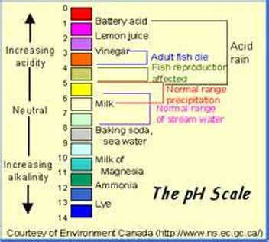
Ab chem is everywhere

Slide 58
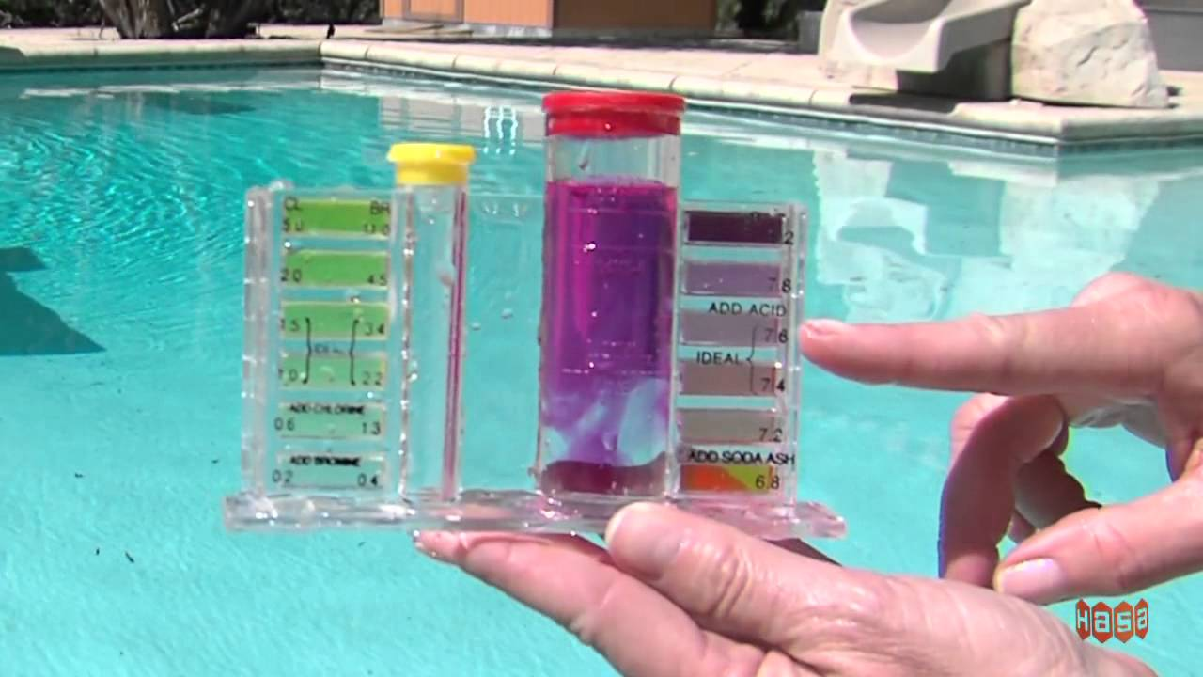
Real Life applications of acids and bases
Adjusting the pH in your swimming pool! Adding certain amounts of Chlorine => sodium carbonate to raise the pool pH and muriatic acid to bring the pH back down. (It’s kind of like mass titrating)

Slide 59
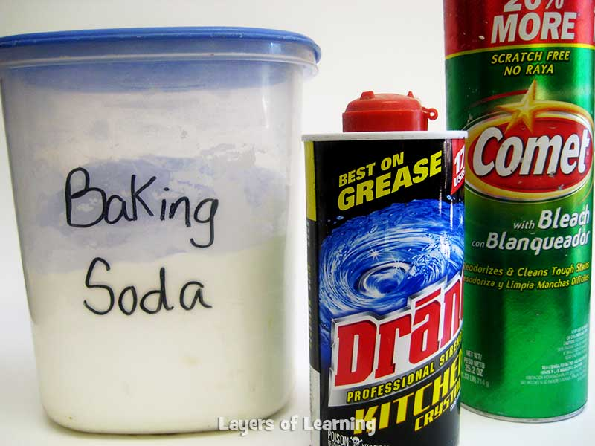
Real life applications
Washing your clothes! Bases like laundry detergent have a high pH
High alkalinity attacks fatty and oily soils
So, oil stains are broken down into component parts! easier to remove

Slide 60

Real life applications
When your stomach is overly acidic and causes reflux, antacids like Tums help neutralize stomach acid.

Slide 61

I hope you learned a lot
Remember, work hard play harder! Thanks all folks!

